Slide 1
Install MongoDB

Slide 2
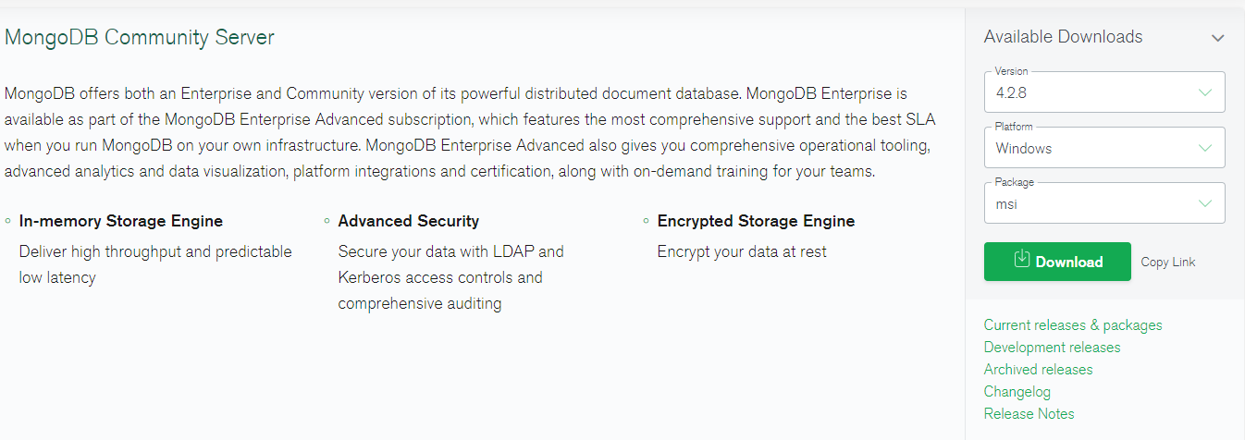
Install MongoDB
MongoDB is another tool we’ll be using in this course.
To Download MongoDB navigate to: https://www.mongodb.com/try/download/community

Slide 3
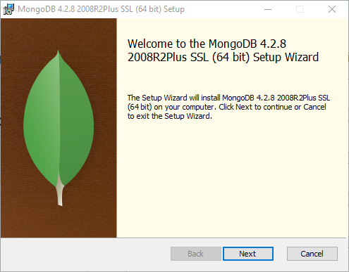
Install MongoDB (continued)

Slide 4
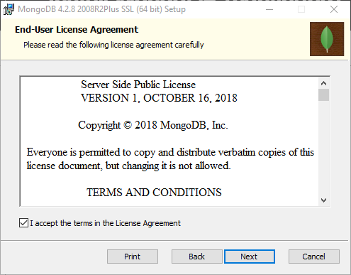
Install MongoDB (continued)

Slide 5
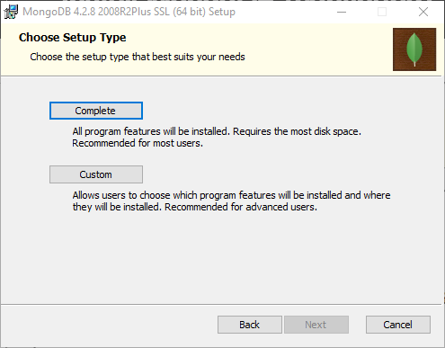
Install MongoDB (continued)
Select Custom and then Next.

Slide 6
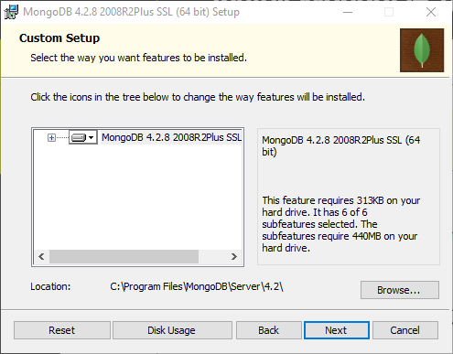
Install MongoDB (continued)

Slide 7
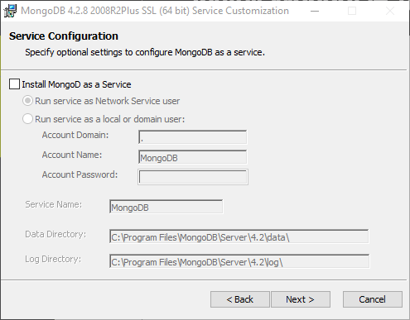
Install MongoDB (continued)
Do not install MongoDB as a service.

Slide 8
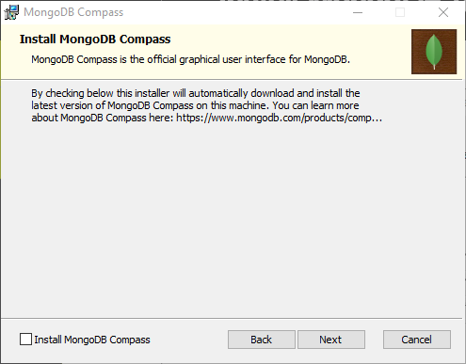
Install MongoDB (continued)
Do not install Compass

Slide 9
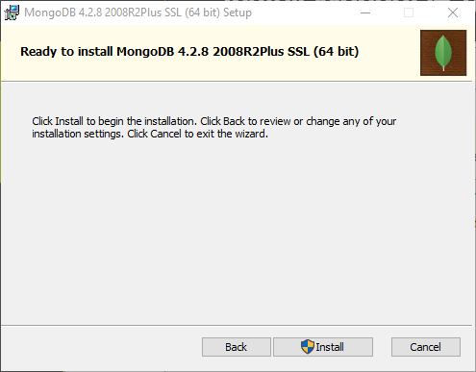
Install MongoDB (continued)

Slide 10
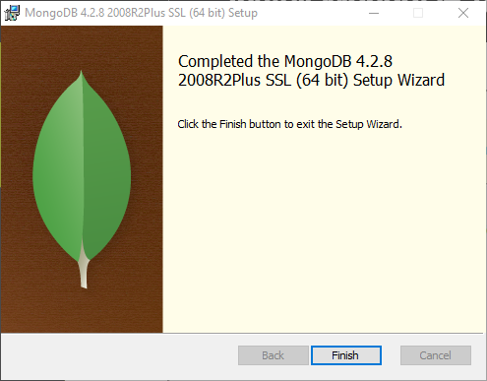
Install MongoDB (continued)

Slide 11
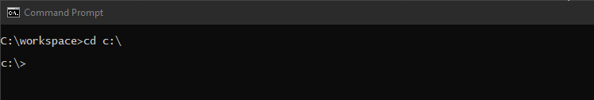
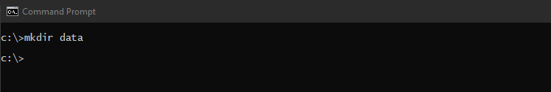
Install MongoDB (continued)
Open a command prompt
Navigate to the root folder on your C: drive by typing the following command: cd c:\
Create a new folder named data by typing the following command: mkdir data

Slide 12
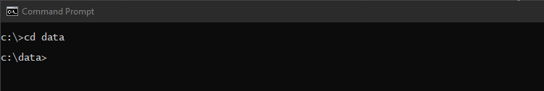
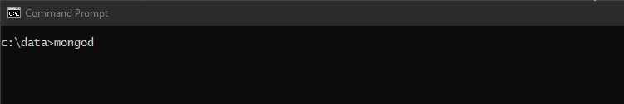
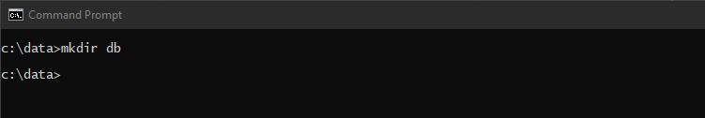
Install MongoDB (continued)
Navigate to the data folder by typing the following command: cd data
Create a new folder named db by typing the following command: mkdir db

Slide 13
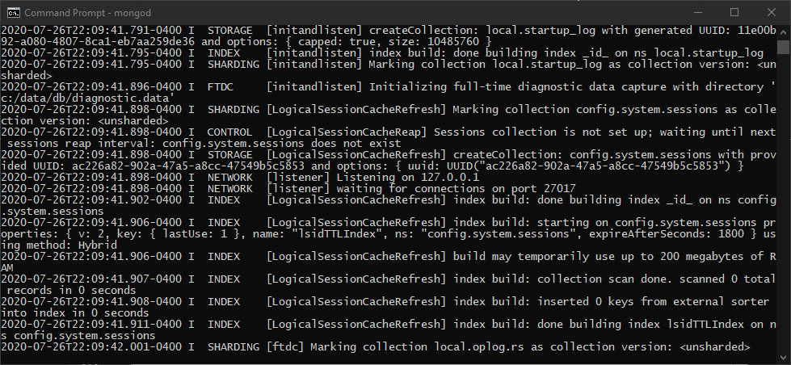
Install MongoDB (continued)
Now test your installation by issuing the following command: mongod
You should see something like:

